Slide 1
Design Categories: Defense
in Depth
and Monitoring/Traceability
--Sri Harsha, CyberEye.

Slide 2
Defense in Depth (DiD)
Security by diversity
If one layer is broken, there is another of a materially different character that needs to be bypassed
Categories: Prevention/Mitigation
Example: Do all of the following, not just one
Use a firewall for preventing access via non-web ports
Encrypt account data at rest
Use a safe language for avoiding low-level vulnerabilities

Slide 3
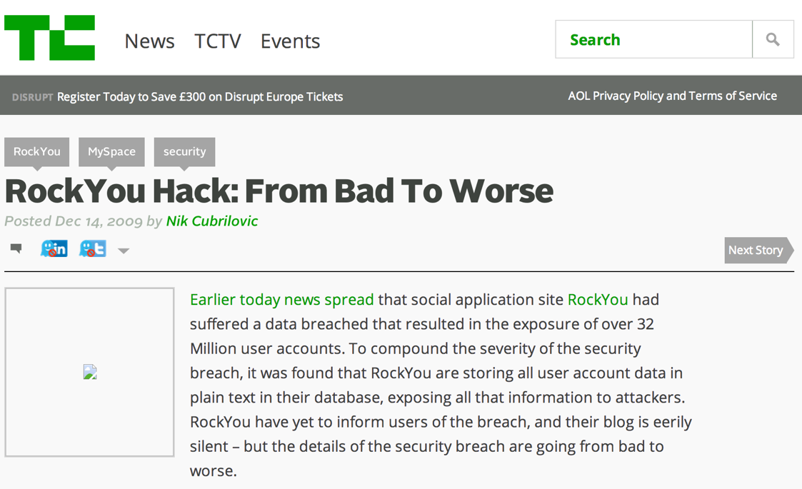
Failure: Authentication Bypass
(poor) passwords can be guessed
Bypassing authentication process intent
Passwords can be stolen
Defense in depth: Should encrypt the password database
Assumes that compromise is possible, and thus requires additional defense

Slide 4
DiD: Use community resources
Use hardened code, perhaps from other projects
E.g., crypto libraries
But make sure it meets your needs (test it; cf. Heartbleed!)
Vet designs publicly: No security by obscurity
Stay up on recent threats and research
NIST for standards
OWASP, CERT, Bugtraq for vulnerability reports
SANS Newsbites for latest top threats
Academic and industry conferences and journals for longer term trends, technology, and risks

